Slide 1

Customer Shopping Behavior Analysis
Understanding shifting purchasing patterns across demographics, product categories, and sales channels is crucial for improving sales, boosting customer satisfaction, and fostering long-term loyalty.

Slide 2

Project Overview
Objective
Goal
Outcome
Analyze consumer shopping data to understand purchasing patterns and key drivers behind decisions.
Improve sales, boost customer satisfaction, and foster long-term loyalty through actionable recommendations.
Optimize marketing and product strategies based on data-driven insights.

Slide 3

Dataset Summary: Architecture & Scope
Total Volume
3,900 unique transaction records.
Feature Set
18 specialized variables capturing demographic, transactional, and behavioral dimensions.
The dataset is highly complete, with only 37 missing values in "Review Rating".

Slide 4


Key Variables Included
Demographics
Age, Gender, Location.
Transactional Data
Item, Category, Purchase Amount (USD), Payment Method.
Behavioral Indicators
Review Rating, Frequency, Previous Purchases.
Logistics & Incentives
Shipping Type, Season, Subscription Status, Discount Applied, Promo Code Used.

Slide 5

Exploratory Data Analysis (EDA) with Python
01
Data Loading & Exploration
Imported dataset using Pandas; used data.info() and data.describe() for initial insights.
02
Missing Values & Standardization
Identified and replaced 37 missing "Review Rating" values; renamed columns to snake case.
03
Feature Engineering
Created age_group and purchase_frequency_days columns.
04
Data Consistency & Integration
Removed redundant promo_code_used; loaded data into PostgreSQL database.

Slide 6
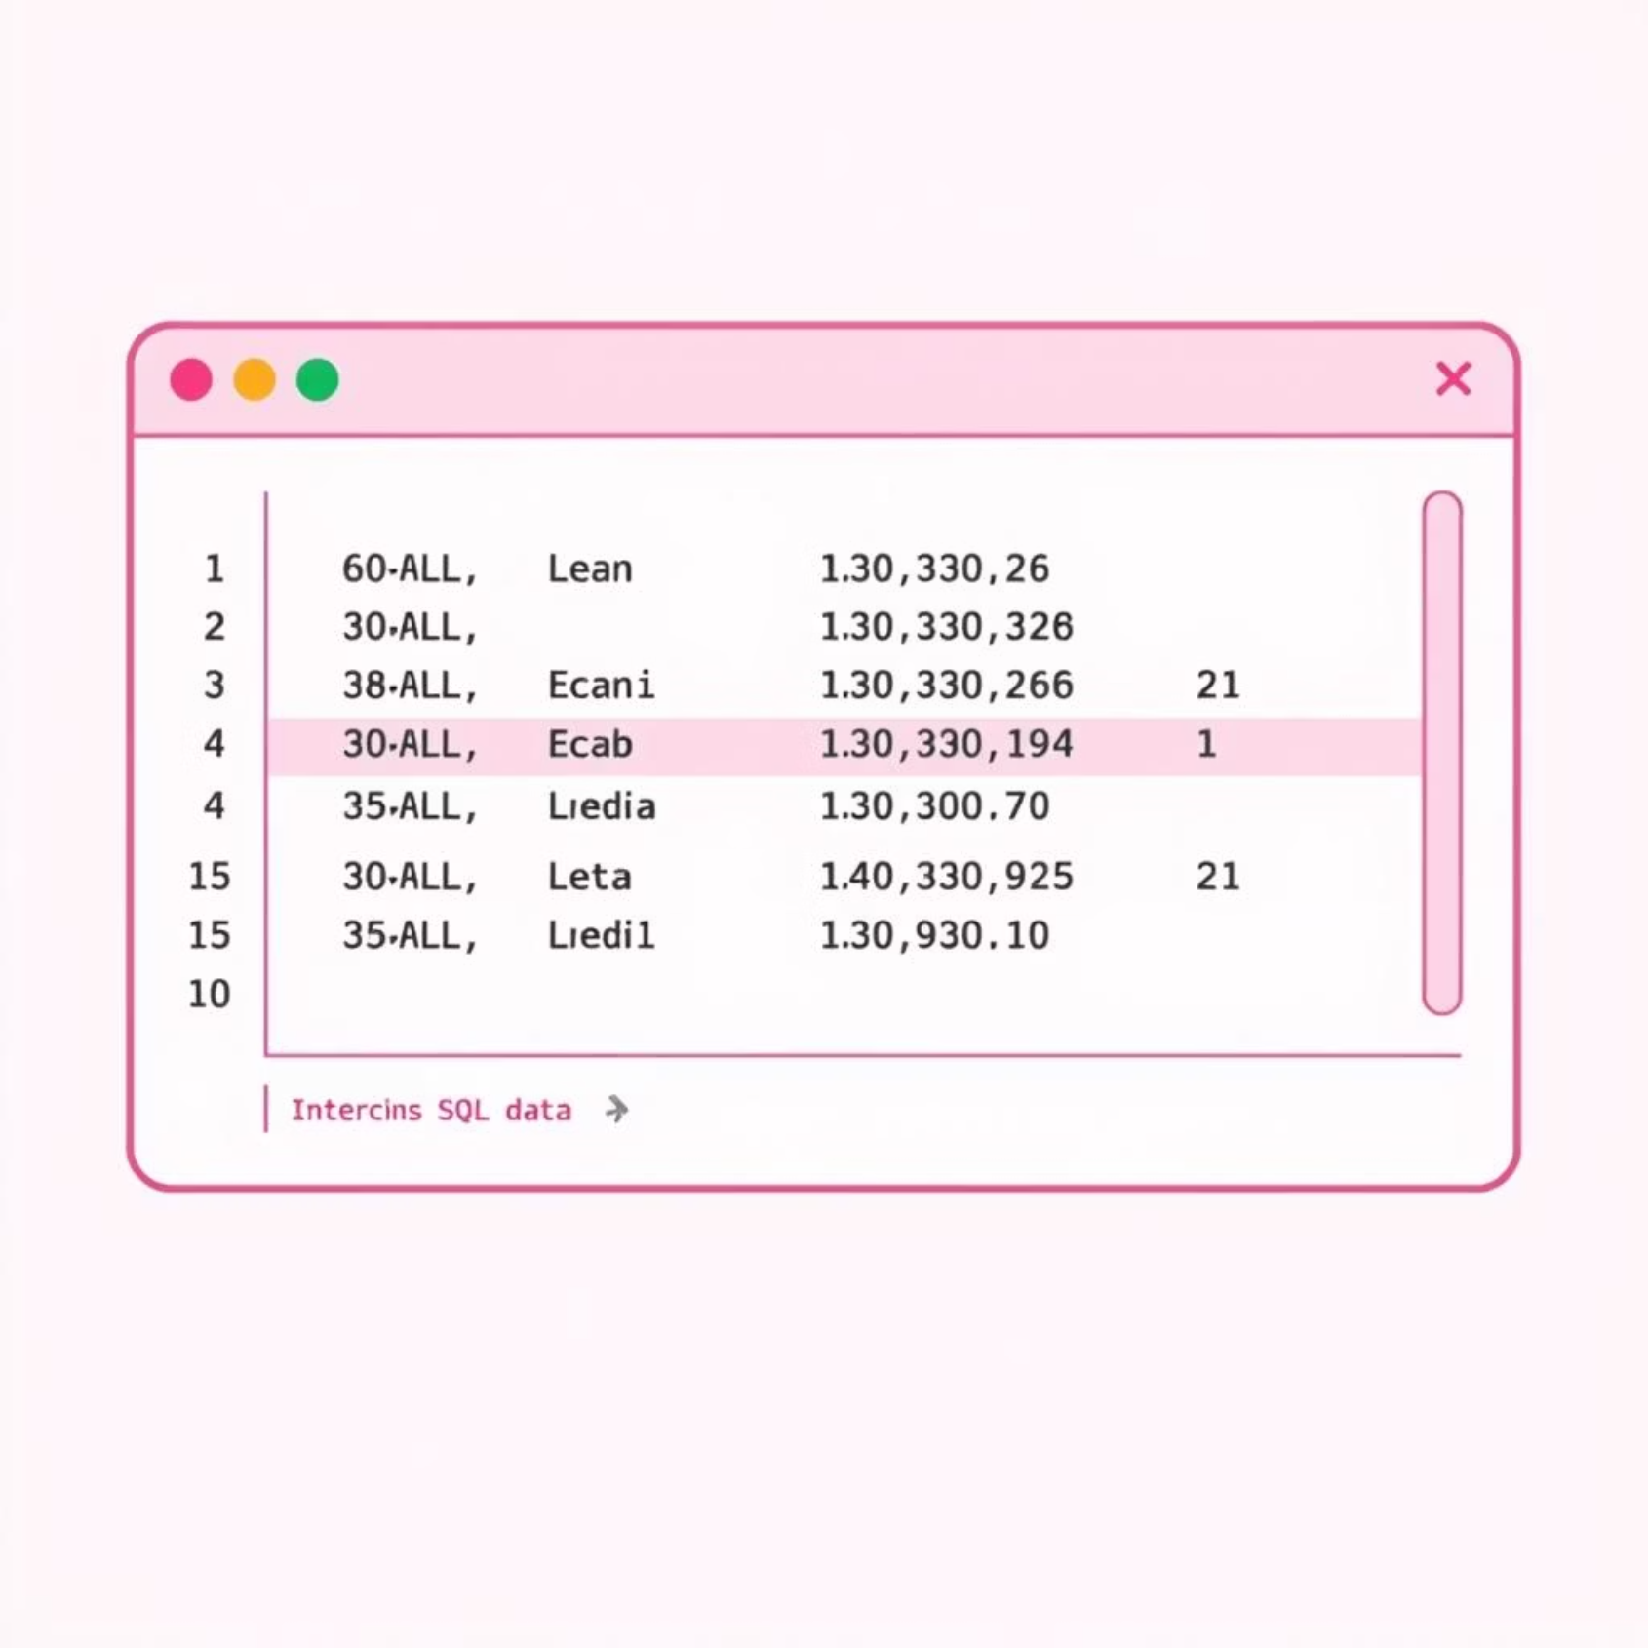
Business Question Analysis Using SQL
Gender-Based Revenue
Male customers contribute 68% ($157,890) of total revenue.
Top 5 Highest-Rated Items
Gloves (3.86), Sandals (3.84), Boots (3.82), Hat (3.8), Skirt (3.78).
Subscription ROI
Subscribers have higher average purchase amounts.
These SQL analyses provide critical insights into customer behavior and product performance.

Slide 7
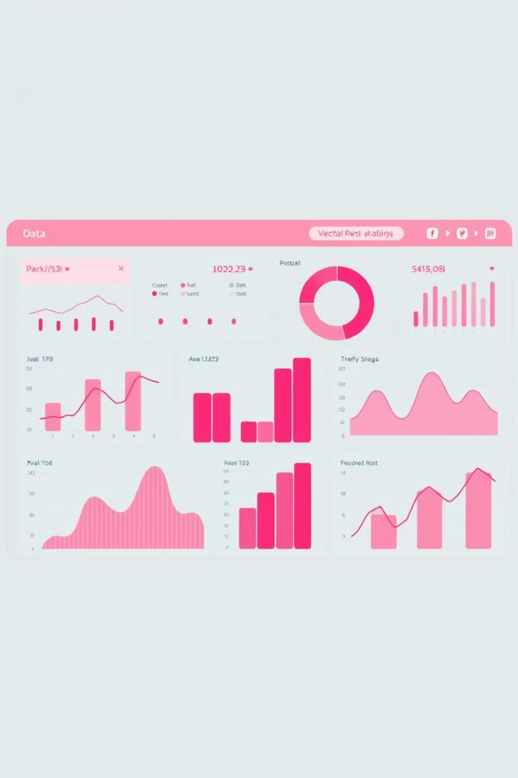
Key Insights from SQL Analysis
1
Discount Utilization
High-value consumers show specific discount trends.
2
Shipping Method Spend
Express Shipping correlates with higher average order value.
3
Price Elasticity
Hats and Sneakers are highly sensitive to discounts.
4
Customer Lifecycle
Loyal customers (3,116) dominate, with 83 new customers.

Slide 8
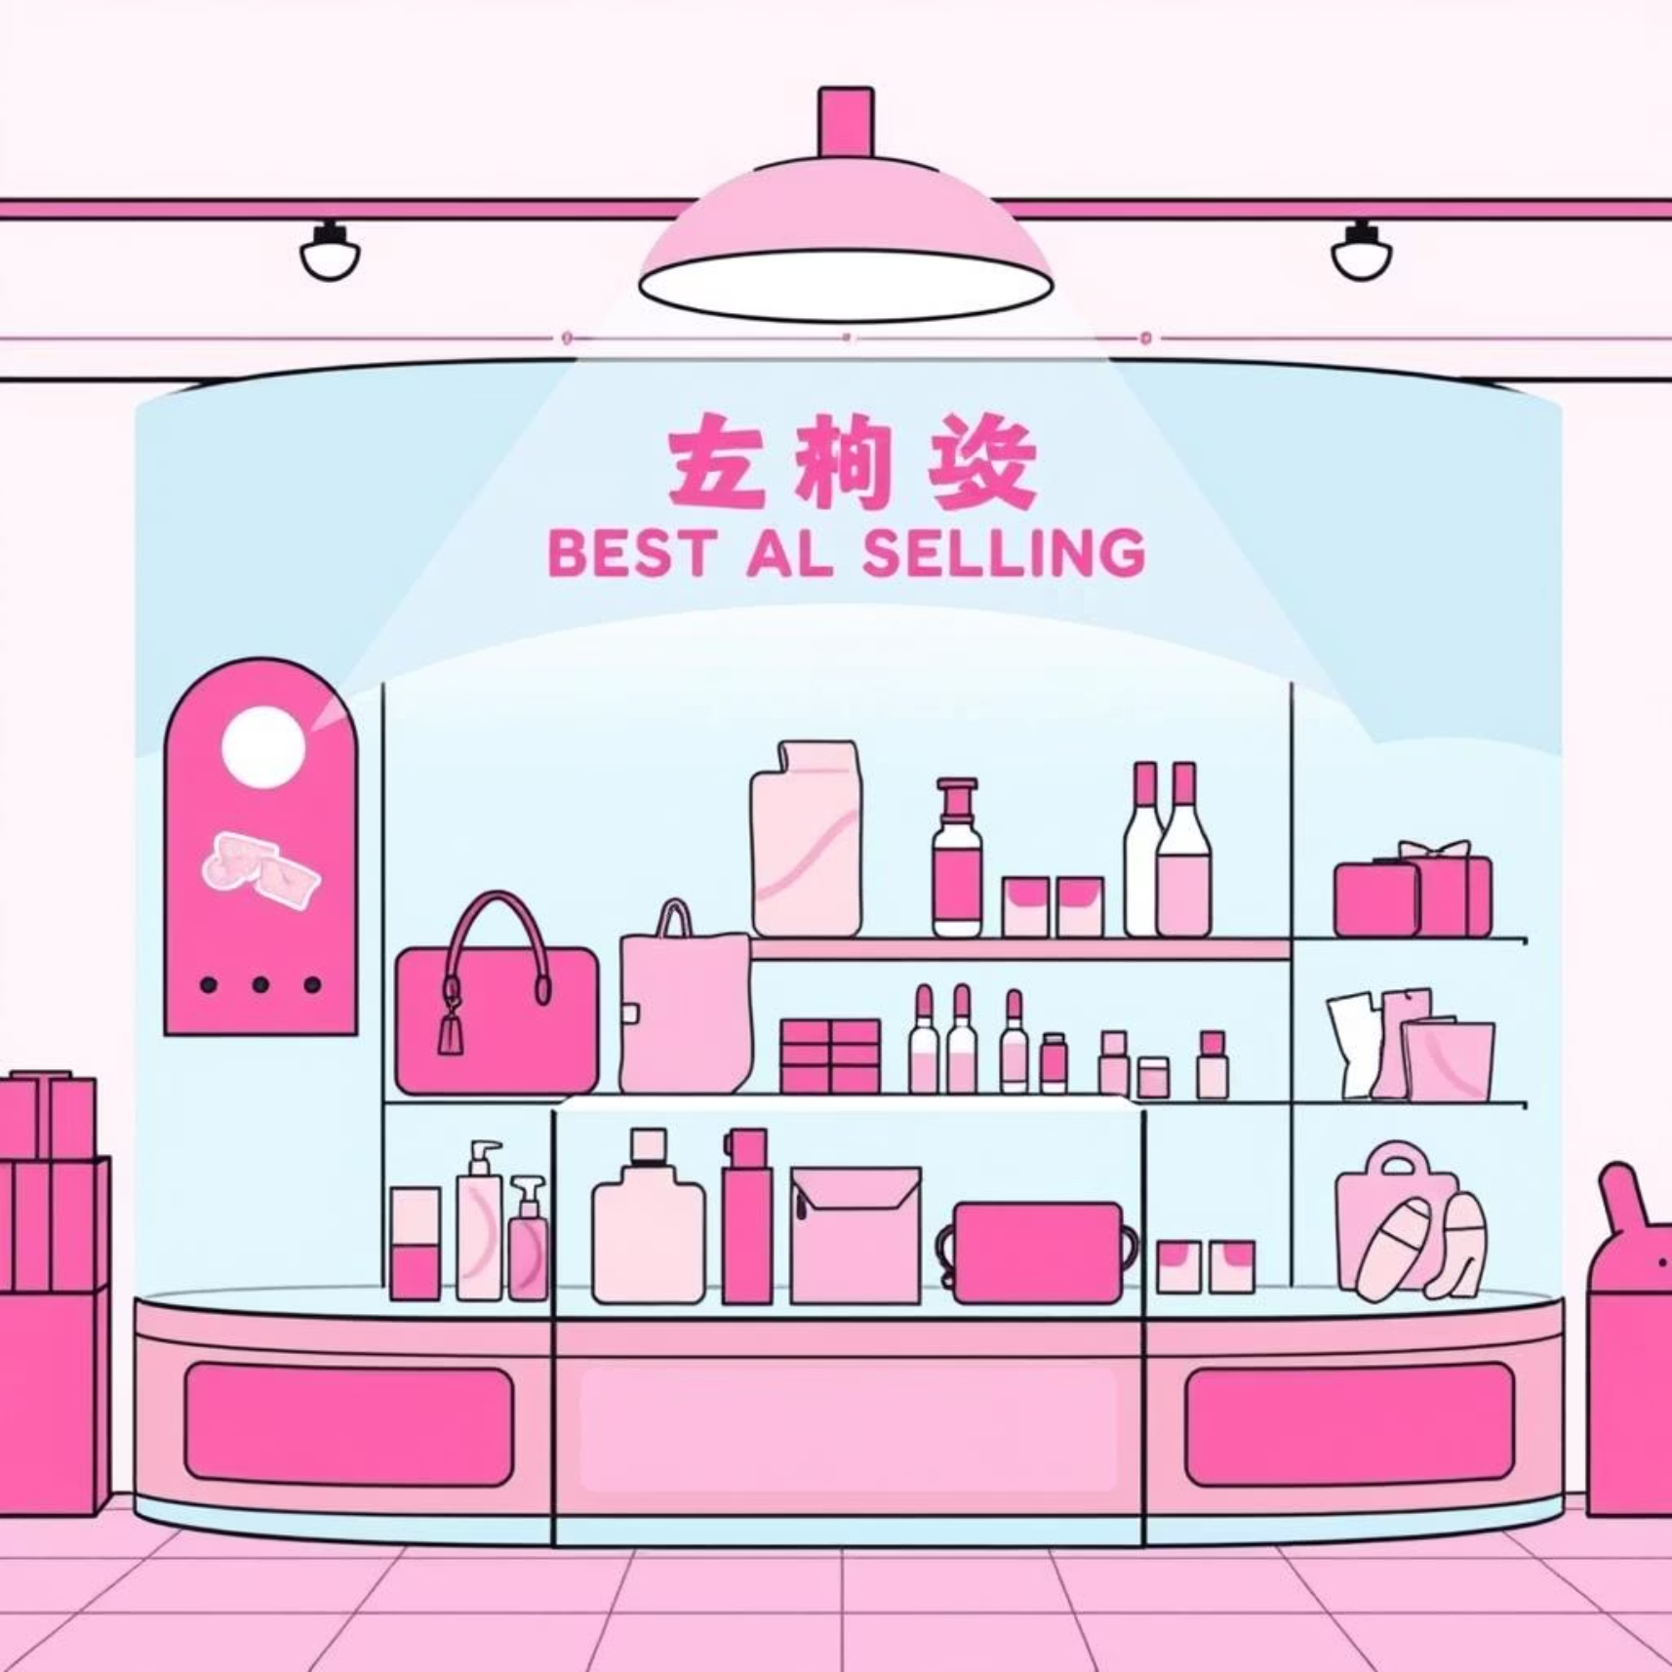
Hero Product Performance & Demographics
Hero Products
Jewelry, Sunglasses, and Belt are top in Accessories. Blouse, Pants, and Shirt lead in Clothing. Sandals are top in Footwear.
Retention Opportunity
2,518 non-subscribing repeat buyers present a conversion opportunity.
Age Cohort Revenue
Revenue is consistent across Young Adult, Middle Aged, Adult, and Senior groups, with Young Adult leading at $62,143.

Slide 9
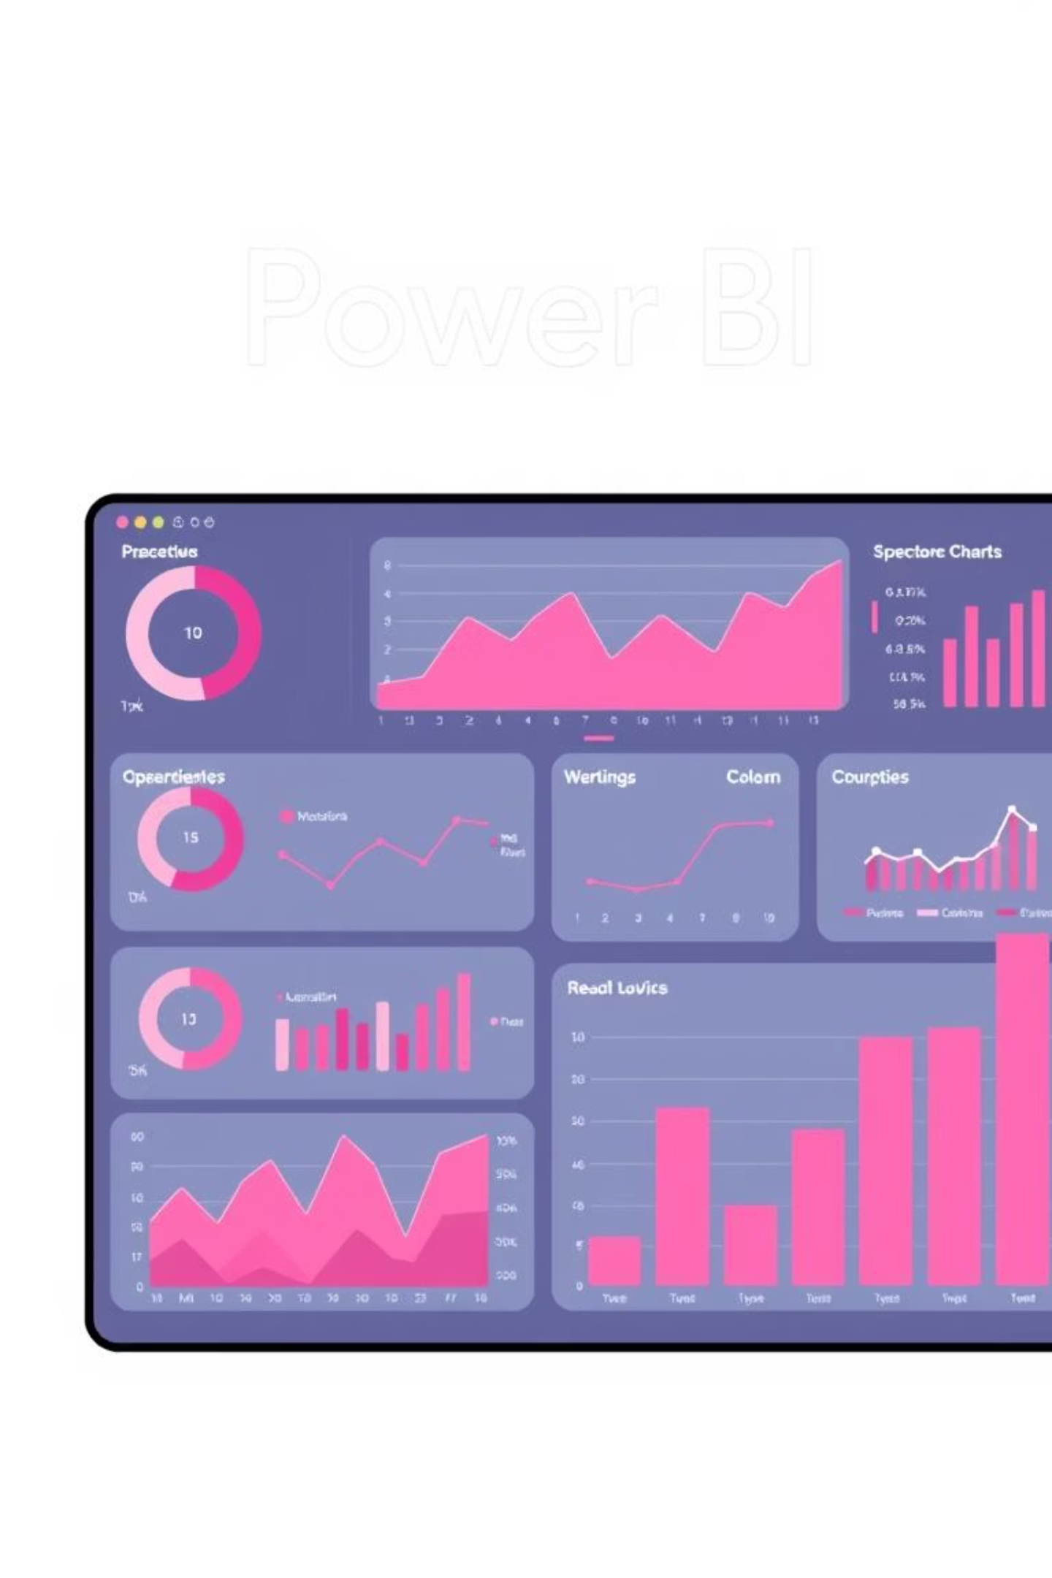
Customer Behavior Dashboards
Interactive dashboards provide a comprehensive visual overview of customer behavior, enabling quick insights and data-driven decisions.

Slide 10
Strategic Business Recommendations
Targeted Loyalty Conversion
Convert 72.4% of repeat buyers into subscribers with a "loyalty bonus" campaign.
Male-Centric Growth
Prioritize marketing budgets towards male-focused channels and product categories.
Strategic Discounting
Use high-elasticity items (Hats, Sneakers) as "loss leaders" for traffic generation.
Premium Shipping Upsells
Implement "Free Express Shipping on orders over $75" to incentivize larger basket sizes.
Quality-Led Marketing
Feature highly-rated products (Gloves, Sandals, Boots) in "Customer Choice" modules.
Age-Specific Campaign Timing
Broad-reach branding for 26-65 age cohorts; aggressive "first-purchase" incentives for 18-25 and 66-75 groups.

